Slide 2
Mikael Nystrom Viktor Hedberg
Building a Resilient Hybrid IT-Infrastructure - Minimize the Impact of a Breach

Slide 3
Agenda
The Network
Securing the control plane
Virtualization
Manage Windows Server
Securing the backup

Slide 4
The Story Behind...
Once upon a time, there was a company with a network infrastructure that was held together by digital duct tape and outdated software. The employees often joked about the slow internet speeds and frequent crashes, but little did they know, their network was a ticking time bomb.
One dark and stormy night, a group of cyber criminals, lurking in the shadows of the internet, discovered this vulnerable network. With a few keystrokes, they breached the company’s defenses, slipping past the outdated firewalls and weak passwords like a hot knife through butter.
The next morning, chaos reigned. Computers were locked, sensitive data was stolen, and the company’s operations ground to a halt. The IT team scrambled to contain the breach, but the damage was done. It was a harsh lesson in the importance of robust cybersecurity measures and the dangers of neglecting network infrastructure.

Slide 5
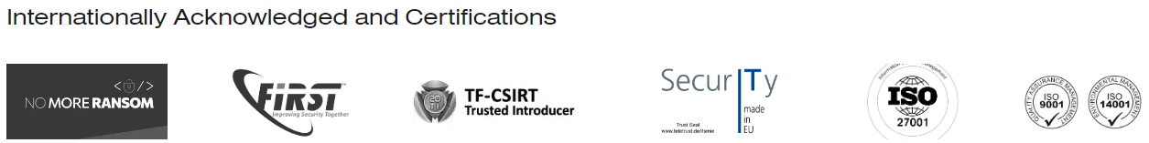
CSIRT
Statistics:
Number of incidents yearly 170-200
Concurrent incidents 10-15
Time spent yearly around 35.000hrs
That gives us “some” insights

Slide 6

The administrator that really needed to patch...
Story
“Forced” to run Windows Update
Used Remote Desktop sessions
Interactively logging to systems using high value credentials
Outcome
Fully patched
Fully ransomware with in 4 hours
Progress
Primary systems was up within 2 weeks
Some system was up after 6 months
Data was lost
Notes:
What was going on:
The administrator was painfully aware that patches was not update to date on all system
The administrator synced the WSYS server and approved all patches
The administrator then used Remote Desktop Manager and connected to each and every system
The administrator interactively executed Windows Update on all server
All server was patched after more then 16 hours of work
Great job!

Slide 7
Could this have been prevented?
Yes

Slide 8

Of course we have logging enabled...
Story
Firewall, VPN, Windows, Azure, etc, etc
Outcome
Customer hacked
Progress
No patient Zero
Logs stored locally in each system
Standard environment
Forensic investigation was not possible
No entry point
Notes:
What was going on:
The administrator was painfully aware that patches was not update to date on all system
The administrator synced the WSYS server and approved all patches
The administrator then used Remote Desktop Manager and connected to each and every system
The administrator interactively executed Windows Update on all server
All server was patched after more then 16 hours of work
Great job!

Slide 9
Could this have been prevented?
Yes

Slide 10

Yes, we manage our accounts
Story
Service accounts with high privs.
Active Directory is full of old references to admin accounts, servers.
Bad control and lifecycle management of AD objects
Outcome
Every service “works”.
Progress
Restore from backup (not all systems)
Recover from datamining (some systems)
Primary functions was up after 2 weeks
Data was lost
Exposure of Domain Admin on all servers
The attacker needs to compromise one (1) server
Notes:
What was going on:
The administrator was painfully aware that patches was not update to date on all system
The administrator synced the WSYS server and approved all patches
The administrator then used Remote Desktop Manager and connected to each and every system
The administrator interactively executed Windows Update on all server
All server was patched after more then 16 hours of work
Great job!

Slide 11
Could this have been prevented?
Yes

Slide 12
Samples

Slide 13
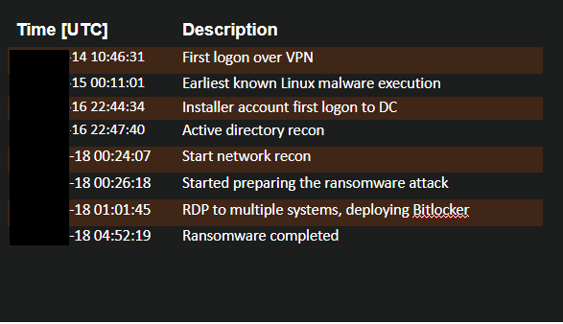

Slide 14
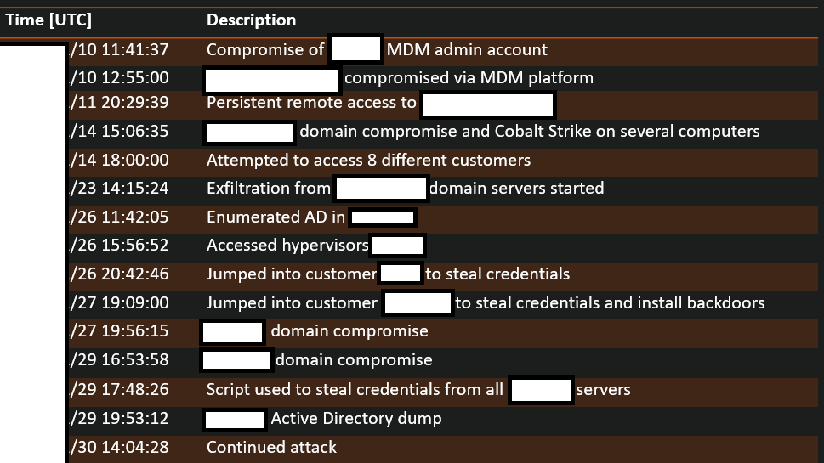

Slide 15

Single Sign is awesome, but not for everyone
Story
All systems are well connected.
Administrators have a single admin account
The admin account(s) was Domain Admin, Global Admin, and vSphere admin
Outcome
The administrators have a very easy way to work on daily basis.
The attacker gained access from a password spray and became the “almighty” easy.
The attacker encrypted the VMs using a GPO as well as the storage in VMware
Progress
Restore from backup (not all systems)
Recover from datamining (some systems)
Primary functions was up after 2 weeks
Data was lost
Notes:
What was going on:
The administrators had multiple accounts, one for user access and one for admin access.
The administrative accounts were synced/integrated with the hypervisor solution and the backup solution.
The administrative accounts were also Global Administrators in Azure AD.
Remote Desktop Connections from the user endpoint was the preferred way of working.

Slide 16
Could this have been prevented?
Yes

Slide 17

Isolation is lonely
Story
All systems are well connected.
The administrator might use different admin accounts.
From one single device it is possible to “ping” everything
Outcome
The attacker got in a laptop, scanned the network
Progress
Restore from backup (a few systems)
Recover from external consultans (randomly stored data on usb devices)
Primary functions was up after 2 weeks
Data was lost
Eventually managed to get in to Vmware
Found VMware, Hyper-V, ILO/Idrac
Launch the ransomware attack.

Slide 18
Could this have been prevented?
Yes

Slide 19

The backup solution with no capability to restore the data
Story
Backup solution was running in WORKGROUP
Data was stored on NAS devices
NAS Device password was used in other locations
Outcome
Backup was working as expected
The attacker scanned the network and found the NAS devices, erased them, installed backdoors..
Progress
The attacker was “unlucky”, they destroyed the server that was used in the attack, so many VMs was unaffected.
Rebuild many functions

Slide 20
Could this have been prevented?
Yes

Slide 21

Next Generation Firewall's are awesome, but...
Story :
Advanced firewalls was installed, Windows firewall was disabled
No need of EDR or AV, since the advanced firewalls should detect anything
Outcome :
The attacker gained access to the network using a test account in the VPN solution
The attacker scanned the network and found the NAS devices
The attacker exported the data on the dark web, formatted the data disks and installed backdoors and executed the ransomware attack.

Slide 22
Could this have been prevented?
Yes

Slide 23

The VPN solution that gave us everything
The VPN solution that gave us more then we could possibly imagine..

Slide 24
VPN solutions...
The attacker “bought” a credential online and logged in, full network access to everything.
The attacker used a vulnerability in the VPN solution, full network access to everything
The attacker tried with the default credentials in VPN solution, full network access to everything
The attacker “asked” a user for the VPN credentials, full network access to everything
The account VPNTest has the password of VPNTest, and no MFA , full network access to everything

Slide 25
Solution
VPN should only be used if the devices is managed.
Controlled by EDR, MDM, etc
Joined to the Domain
VPN should only allow needed communication, very few users needs to logon to the ESXi hosts
VPN should be something like AOVPN, certificate based, machine based.
Note: Once the attacker is in, they invest in scanning to find out what you have... #lifeisunfair

Slide 26

The solution that is not used, except by the threat actors...
Exposed Exchange for collaboration, should have been decommission a few years ago
Exchange hybrid, 3 more mailboxes to move, but
The LDAP port is published on the Internet, something was using it...

Slide 27

Solution is not used anymore
The solution was running, fully connected
The attacker used a Web Shell on the Exchange Server
The SharePoint services account was Domain Admin
The system was terminated on paper 5 years ago...
The attacker could continue to other systems, since there was full trusts to several other domains

Slide 28
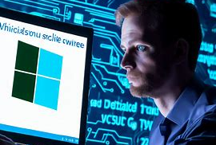
We patch everything, except, that server, that VPN, that firewall, that ILO, that switch, that Idrac, and that client...
Patch solution was in place for Windows Clients and for most servers
Solution was automated with exceptions

Slide 29
Patching is not always easy...
Hardware was in general never patched since first power on (15-20 years)
VPN was not patched for more then 5 years
The attacker used a nice feature named “Create VPN account without being logged on”
Connected to the VPN solution for almost 3 months, the attacker could get access to Active Directly and launchh the attack
Primary functions was up after 2 weeks
Restore using the “I think I have a copy of that” as well as regular backup (external)
Rebuild many functions
Data was lost

Slide 30
Ten immutable laws of cyber security
These laws were written, prior to year 2000
And we are still struggling with these fundamentals...

Slide 31
Ten immutable laws of cyber security
#1 Nobody believes anything bad can happen to them, until it does.
#2 Security only works if the secure way also happens to be the easy way.
#3 If you don't keep up with security fixes, your network won't be yours for long.
#4 It doesn't do much good to install security fixes on a computer that was never secured to begin with.
#5 Eternal vigilance is the price of security.

Slide 32
Ten immutable laws of cyber security
#6 There really is someone out there trying to guess your passwords.
#7 The most secure network is a well-administered one.
#8 The difficulty of defending a network is directly proportional to its complexity.
#9 Security isn't about risk avoidance; it's about risk management.
#10 Technology is not a panacea.

Slide 33
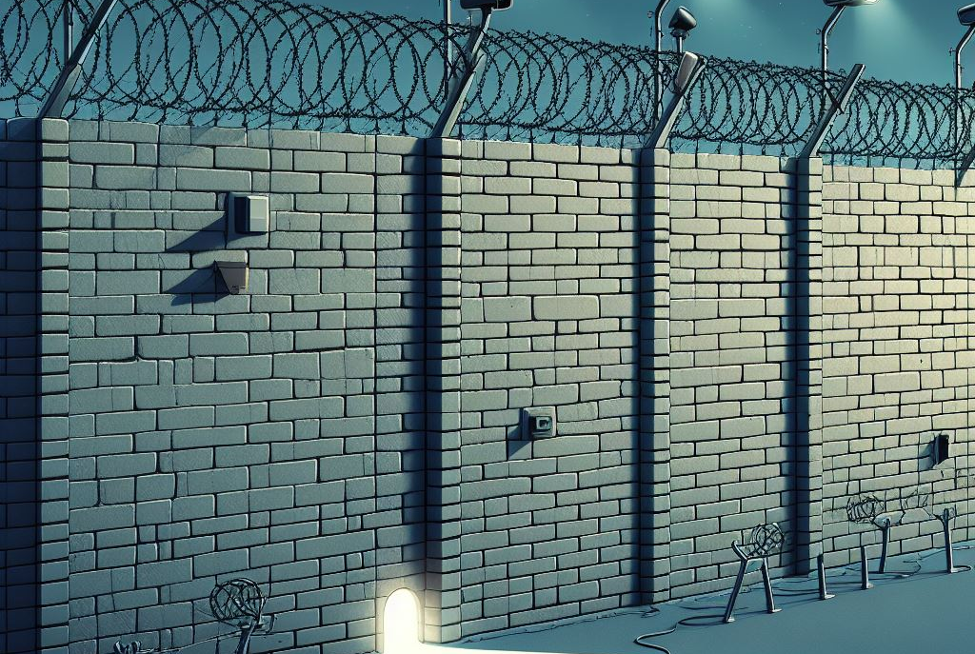
“The threat actor does not care about your security, they care about your weakness, and they only need to find one, tiny hole, one time”

